Slide 1

Introduction to automated screening techniques
Oct 7, 9:00 - 10:30
Devi VEYTIA
Postdoctoral researcher
École Normale Supérieure

Slide 2
Outline
What is the need?
The solution: Machine learning?
Previous applications of machine learning in evidence syntheses
Recent advancements: Transformer model
TD: Encoder model for screening:
Other applications/examples
Notes:
Cathleen

Slide 3
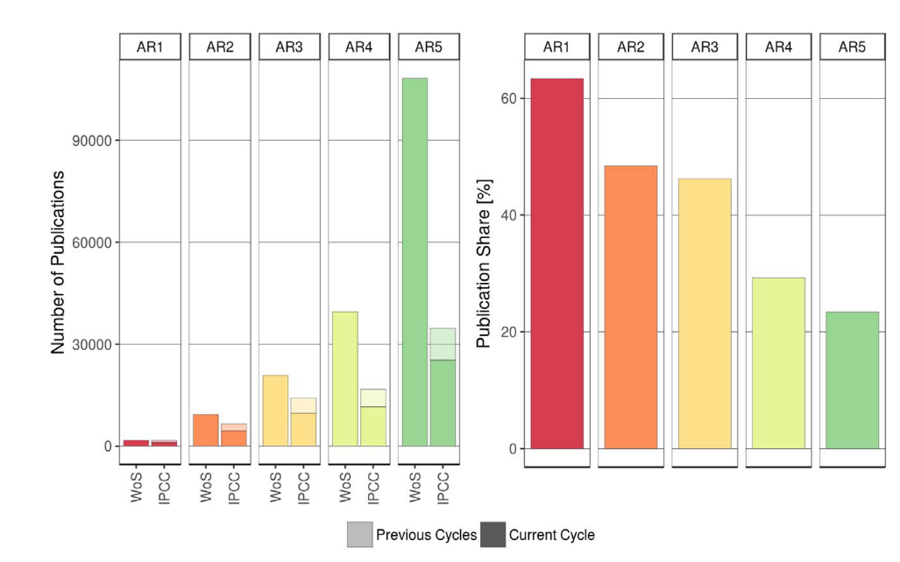
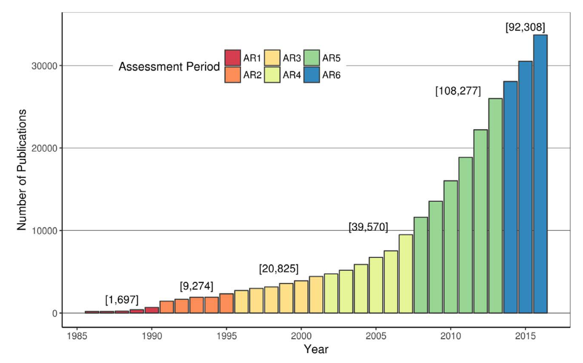
What is the need ?
# Publications is exponentially increasing
What are the implications for evidence syntheses?
Source: Minx et al. 2017
Notes:
Systematic evidence syntheses are time-intensive. Resource constraints are often a limiting factor in determining the scope of the research question.
Even when search strategies are optimized for specificity, review teams are still faced with spending large amounts of time sifting through a large proportion of irrelevant studies.
This underlines the trade-off between:
the exponential increase in scientific publications, which places a limiting pressure driving synthesis questions to become narrower, and
the needs/motivations of researchers and decision-makers who often require syntheses of broad-scale topical questions within narrow time frames.
Also this introduces increased chance for human error just due to fatigue

Slide 4

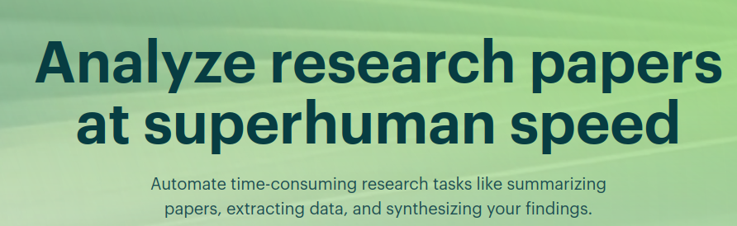






The solution: Machine learning?
taskade.com
Elicit.com
https://consensus.app/
Notes:
Recent developments in text mining and machine learning techniques can help to expedite certain time-consuming steps of the evidence synthesis process, reducing the manual effort required and making more large-scale and timely evidence synthese possible
My aim is not to go through all of these tools, but to talk in general terms about how these tools work, so you can be empowered to decide if and when they’re useful to you, how to apply them, and to understand some of the strengths and limitations. Each situation and each tool is different, so there is no one method that will work for everyone.

Slide 5
ML in evidence syntheses is new, untested and unreliable
Evidence syntheses have been using unsupervised ML (e.g. topic models and clustering algorithms) for decades.
Topic models:
Describe (and often cluster) documents by quantifying words that occur frequently together
Pros: No need for hand-labelled data or advanced coding knowledge → fast to implement
Cons: No control over the topics → generated automatically by identifying patterns that explain variability in the data, but these groupings may not be interesting to your research question/conceptual framework of the review
Notes:
Advantages: Fast and easy – Useful for scoping the topics of studies before manual coding. Topics informed by data rather than reviewer bias
Disadvantages: The clusters generated automatically do not necessarily reflect the conceptual framework of the review

Slide 6
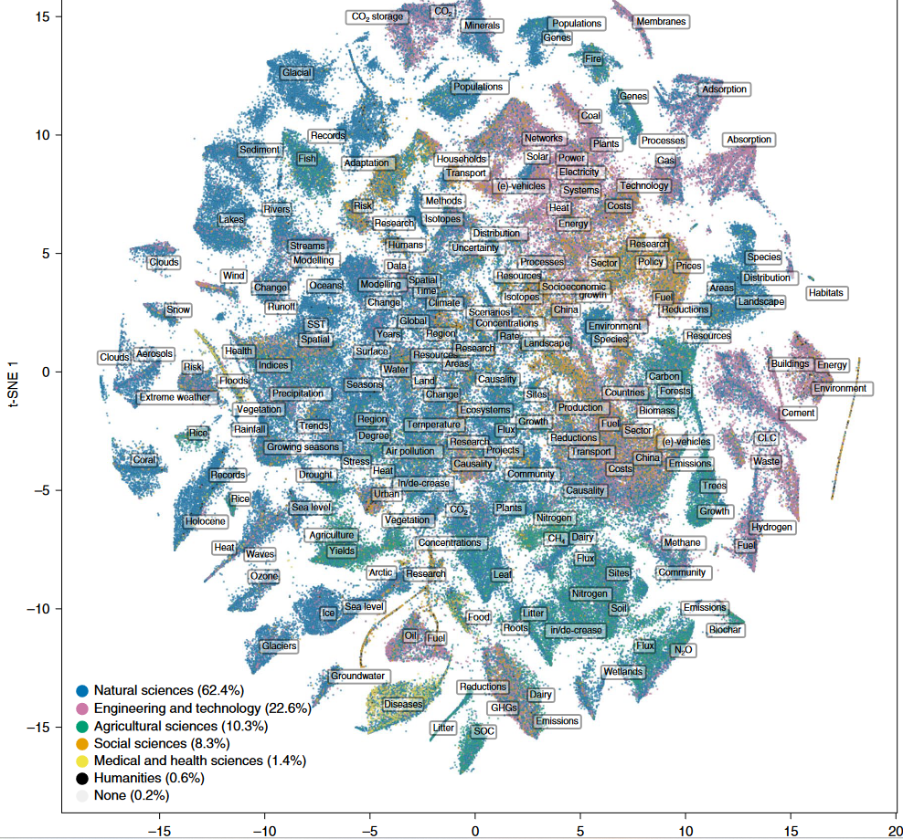
Topic model use cases
Scoping topics of a corpus to refine your research question (e.g. ~ systematic map)
As a screening method to only screen relevant clusters, or screen clusters that are likely irrelevant and exclude the irrelevant references (e.g. https://www.nactem.ac.uk/robotanalyst/ )
climate science and impacts
solution- oriented
Callaghan et al. (2020, NCC)
Notes:
Advantages: Fast and easy – Useful for scoping the topics of studies before manual coding. Topics informed by data rather than reviewer bias
Disadvantages: The clusters generated automatically do not necessarily reflect the conceptual framework of the review

Slide 7

So why now? Why is ML growing in popularity?
Need → the volume of evidence is becoming an increasingly limiting factor
Recent advancements in language models that allow for a more sophisticated interpretation and analysis of text data
Access to large amounts of text data for training
Mathematical advancements that reduce computation requirements (backpropagation)
Advancements in the model architecture (ie Transformer models ), and
Video gamers
So what is a language model?
Language models are probabilistic models. They are designed to predict the most likely next word in a sequence of text based on the context provided by the preceding words
Large Language Models are language models trained on large amounts of data using a transformer architecture
Notes:
Advancements in Graphical Processing Units (developed to get increasingly high-res FPS video games) allowed for the parallel processing of these multi-layered models → allows for multiple model calculations to be done simultaneously needed for multi-level neural networks

Slide 8
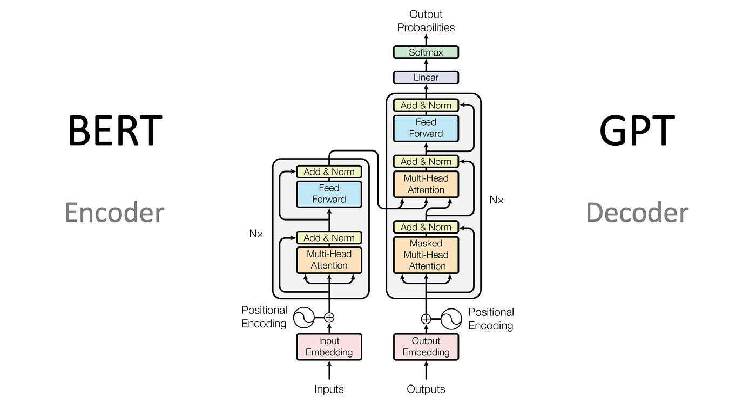
What is a transformer model?
Text classification, where the model must classify a piece of text into one of several predefined categories.
The encoder takes in a sequence of tokens and produces a fixed-size vector representation of the entire sequence, which can then be used for classification.
Language generation, where the model must generate a sequence of words based on an input prompt or context.
The decoder takes in a fixed-size vector representation of the context and uses it to generate a sequence of words one at a time

Slide 9
TD: Encoder block for classification
Literature review example:
Screening → training the model to classify unseen text as relevant or not relevant
How do we train and evaluate a classification model? → Cross validation
Need to provide it with a human-labelled dataset of text and screening decisions to learn from
We divide this data into a training set and test set.
Use the test set to train the model
Use the model to make predictions for the test set, and evaluate how well it does against the ‘true’ labels
Random sample
Human labelled documents
Unseen documents
Labels used to train a ML model
ML model predicts relevance for remaining unseen documents
TD sections: Divide data for cross validation
Adapted from ED Fig. 1,
Callaghan et al. (2021)
Notes:
TD sections: Divide data for cross validation

Slide 10
TD: Encoder block for classification
How to we evaluate the model?
Accuracy: Out of all the predictions we made, how many were true?
Example: We have a data set with 100 articles, and 2 are relevant. Our model could predict every document as irrelevant and it would have 98% accuracy, but it would be a terrible model for our purpose (finding the relevant articles)
So we need a way to maximize our recall of relevant papers, while avoiding including too many irrelevant papers (precision)
Notes:
What problems could this metric create, considering in SLRs, we often have a inclusions << exclusions?

Slide 11
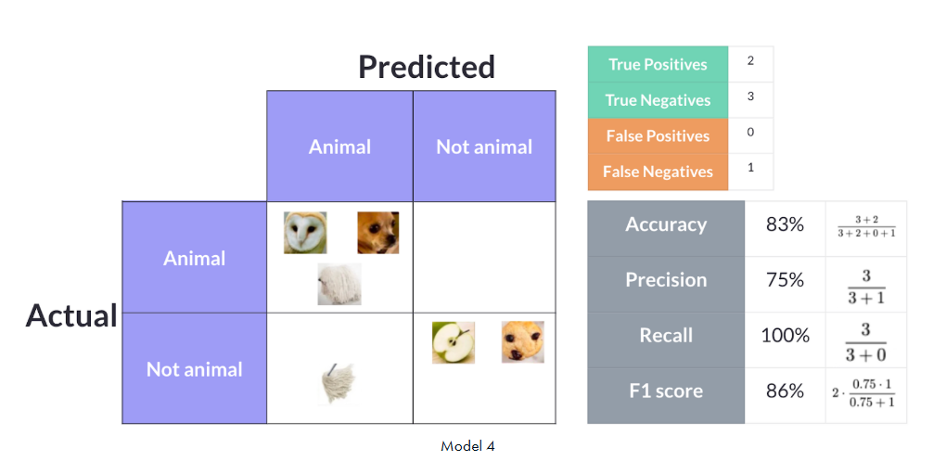
TD: Encoder block for classification
How to we evaluate the model?
F1 Score: combines recall and precision. Because there is a trade-off between precision and recall, F1 measures how the model makes that trade-off.
Recall: how good the model is at finding all the relevant articles (TP/TP+FN)?
Precision: Out of all the articles included, how many are truly relevant (TP/TP+FP)?
Generally aim for F1 > 0.7 for simple (binary) classification problems. For more complex multi-label, F1 scores can be as low as 0.45. But, this implies a larger amount of error – deciding whether a model is fit for purpose depends on the purpose. For a map this is probably sufficient to describe general patterns in the data, but probably not for a rigorous meta-analysis.
TD sections: Define evaluation metrics

Slide 12
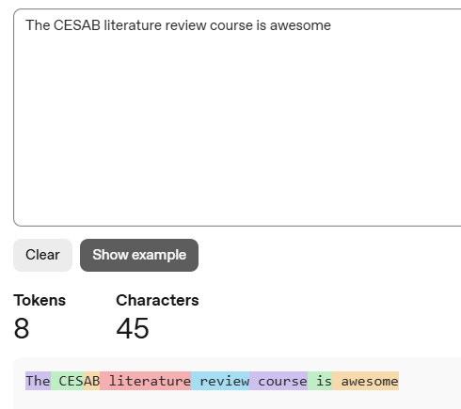
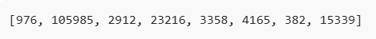
TD: Encoder block for classification
Step 2: Represent text numerically
2.1: Tokenisation
Take raw text, convert it into tokens (numbers). See example of OpenAI’s tokenizer
Sequence of words
Integers
TD sections: Tokenize data

Slide 13
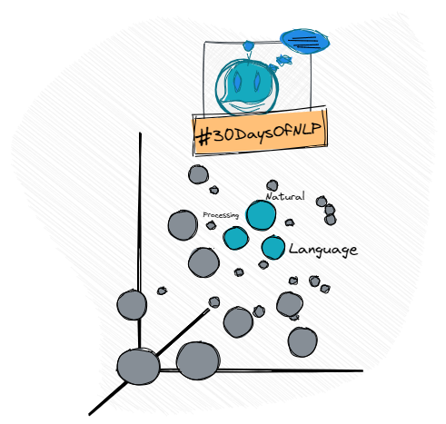
TD: Encoder block for classification
Step 2: Represent text numerically
2.2: Input embedding + positional encoding
For each token, you give the model a vector of numbers to train, as well as information about its position in relation to the other words in the sentence.
Each token (integer) is accompanied by a vector
A sequence of vectors → an embedding matrix where the i-th row of the embedding matrix = the embedding of the i-th token (this is a trainable parameter).
At the end of each vector, adds information on position of the token in the sentence
Why: to train matrix that represents high-dimensional vector space where semantic relationships between tokens become mathematical relationships
Sequence of words
matrix of vectors
Integers

Slide 14
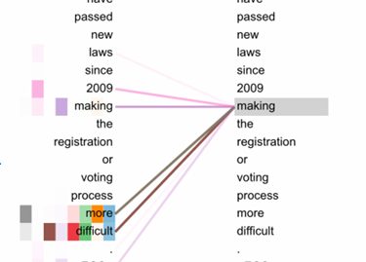
TD: Encoder block for classification
Step 3: Attention
The model uses these inputs to calculate the relative meaning of the word inside the sentence, because depending on the context, the same word can have different meanings
‘more’ and ‘difficult’ contribute to the word ‘making’. So rather than its generic meaning, it’s related to making something more difficult.
Step 4: Classification
Encoder produces an output matrix numerically describing the text, which is then matched with the human label (e.g. relevant or not) to train a classification layer.
TD sections: Calculate attention weights & train classification layer
Notes:
So when developing an intuition for interpreting how these models analyse text data, we have to think beyond keywords. Additionally this is why for a transformers model, you don’t alter the text data or remove stop words.

Slide 15

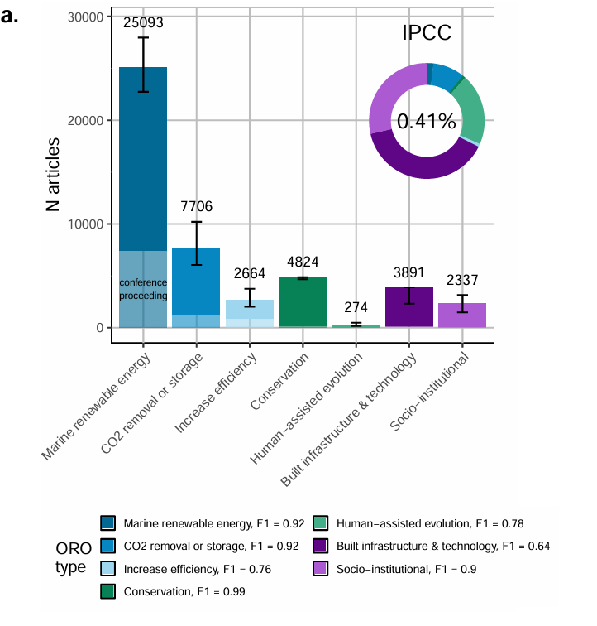
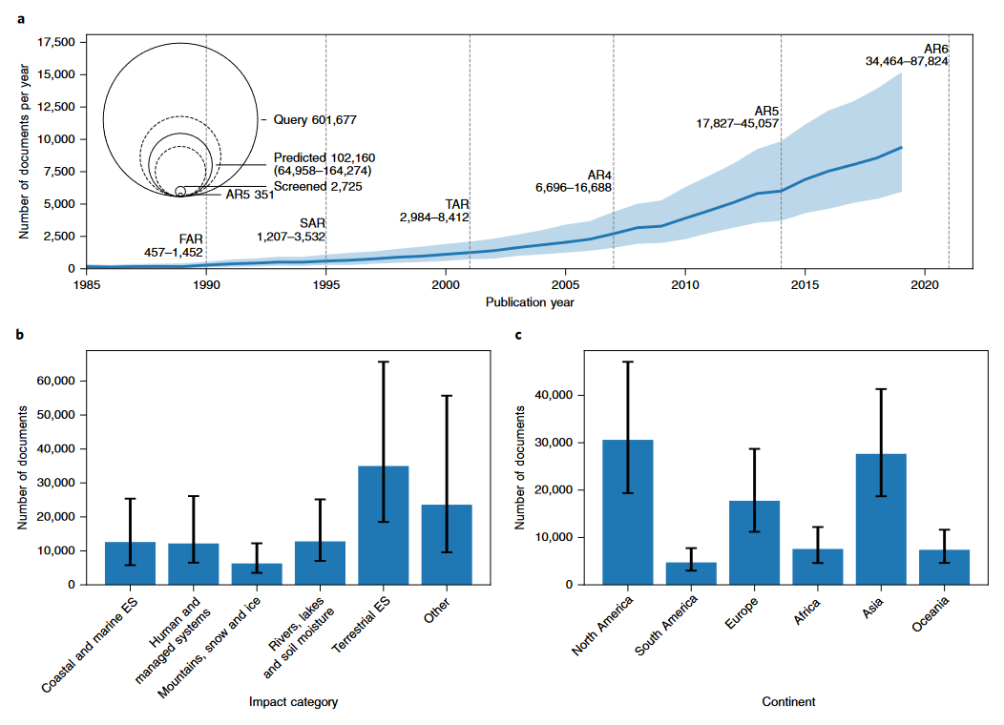
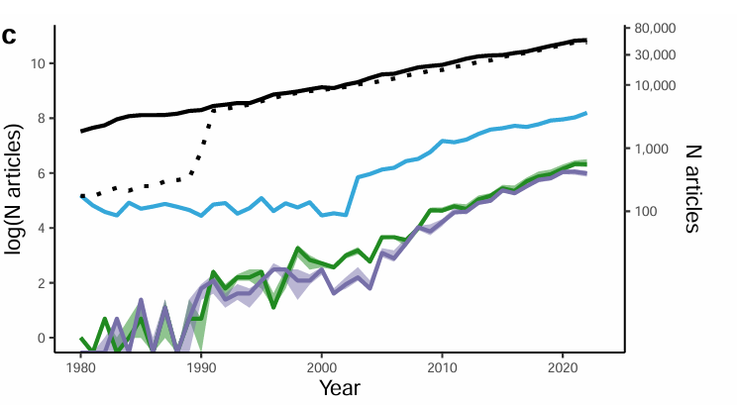
Examples in the literature
Veytia D.,..., Langridge J., et al (Accepted, npj Ocean Sustainability)

Slide 16


Strengths & Considerations
Strengths
Can describe large corpuses of evidence that would otherwise not be possible
Considerations:
Human labelling + training the model still takes time & expertise
No guarantee that the model will perform well
Risk that some areas of the literature are not sufficiently present in the training sample, which would lead them to be under-represented in the final outcome.
Hidden biases…

Slide 17
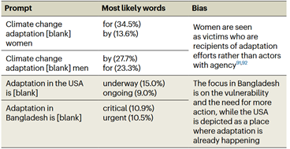
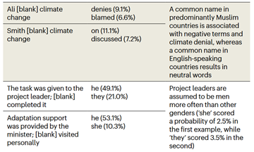
Considerations: Biases
Examples of potential bias using the ClimateBERT language model to fill in the blank, from: 10.1038/s41558-023-01890-3

Slide 18
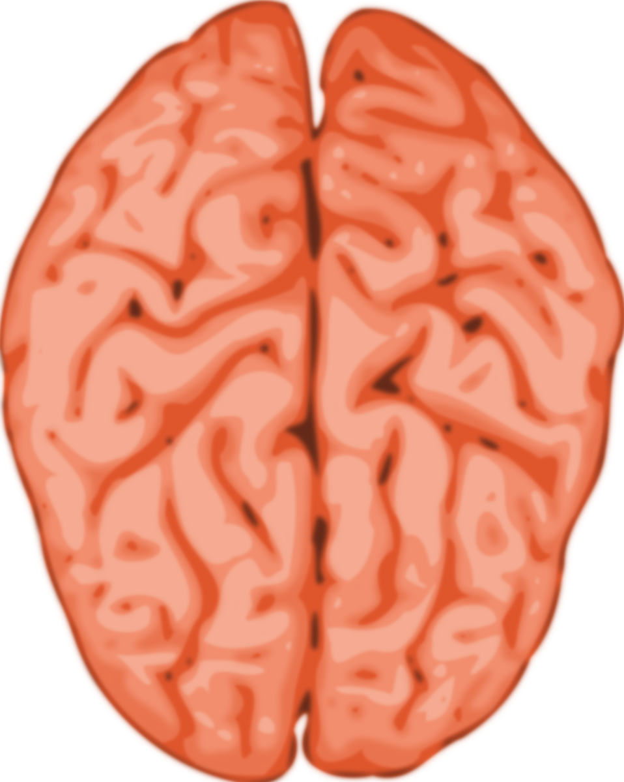

Other applications: Relevance ranking
Model that predicts relevance ranking
( e.g. method Cohen et al 2009 ; e.g. use. Apriyani et al., 2024 )
Set of article to screen
1
X article screened
4
2
3
Re-organized article to screen
ML model predicts relevance for remaining unseen documents
Notes:
As a reviewer applies screening decisions to article text, these data are used to update a model which predicts relevance for the remaining unseen documents. Thus, rather than viewing the documents in no particular order, those most similar to the studies already included are moved to the top of the list. This increases the probability that the next document viewed will be included in the review. A reviewer need only screen until their inclusion rate drops below a certain threshold (e.g. 5% in Cheng et al., 2023) rather than screening all the documents.
Strengths: Can significantly reduce review effort
Limitations: Effectiveness is dependent on the studies already identified being representative of those remaining, there is still a size limitation on the scope of the review, as all relevant articles still need to be manually screened.

Slide 19
Other applications: Relevance ranking
Model that predicts relevance ranking
( e.g. method Cohen et al 2009 ; e.g. use. Apriyani et al., 2024 )
Set of article to screen
1
X article screened
4
2
3
Re-organized article to screen
ML model predicts relevance for remaining unseen documents
Notes:
As a reviewer applies screening decisions to article text, these data are used to update a model which predicts relevance for the remaining unseen documents. Thus, rather than viewing the documents in no particular order, those most similar to the studies already included are moved to the top of the list. This increases the probability that the next document viewed will be included in the review. A reviewer need only screen until their inclusion rate drops below a certain threshold (e.g. 5% in Cheng et al., 2023) rather than screening all the documents.
Strengths: Can significantly reduce review effort
Limitations: Effectiveness is dependent on the studies already identified being representative of those remaining, there is still a size limitation on the scope of the review, as all relevant articles still need to be manually screened.

Slide 20
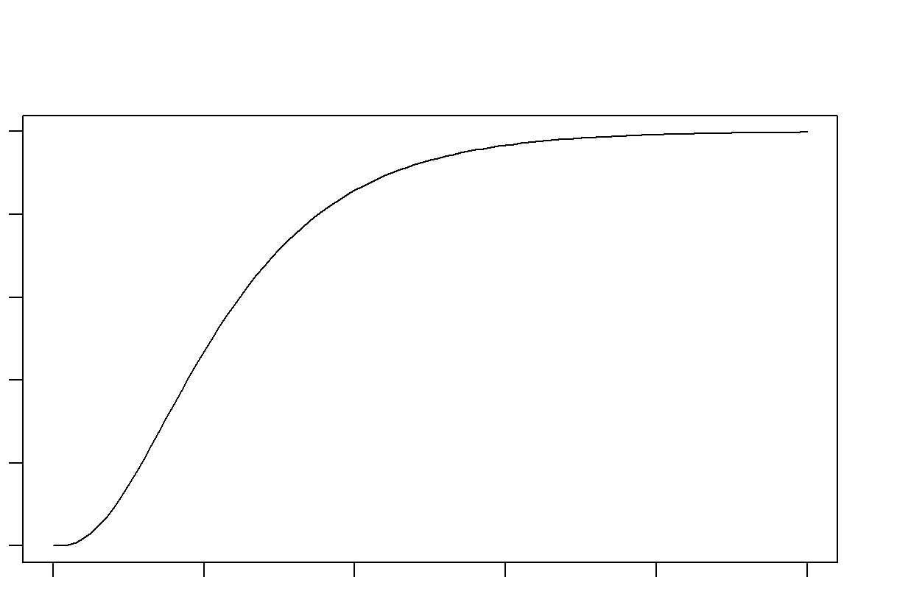
Other applications: Relevance ranking
As a reviewer applies screening decisions to article text, these data are used to update a model which predicts relevance for the remaining unseen documents. ( e.g. method Cohen et al 2009 ; e.g. use. Apriyani et al., 2024 )
Truncate screening : stop the screening effort after a certain inclusion/exclusion ratio.
threshold e.g. 5% in Cheng et al., 2023
Asymptote e.g. Rubenstein et al ., 2023
articles included title
abstract screened
Notes:
As a reviewer applies screening decisions to article text, these data are used to update a model which predicts relevance for the remaining unseen documents. Thus, rather than viewing the documents in no particular order, those most similar to the studies already included are moved to the top of the list. This increases the probability that the next document viewed will be included in the review. A reviewer need only screen until their inclusion rate drops below a certain threshold (e.g. 5% in Cheng et al., 2023) rather than screening all the documents.
Strengths: Can significantly reduce review effort
Limitations: Effectiveness is dependent on the studies already identified being representative of those remaining, there is still a size limitation on the scope of the review, as all relevant articles still need to be manually screened.

Slide 21
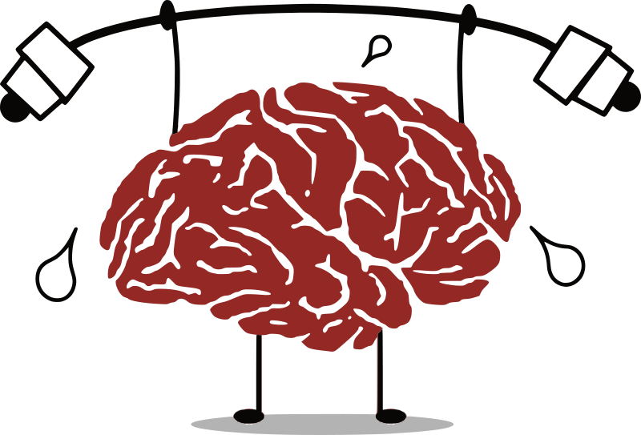


Other applications: Relevance ranking
As a reviewer applies screening decisions to article text, these data are used to update a model which predicts relevance for the remaining unseen documents. (e.g. Apriyani et al., 2024 )
Truncate screening : stop the screening effort after a certain inclusion/exclusion ratio.
threshold e.g. 5% in Cheng et al., 2023
Asymptote e.g. Rubenstein et al ., 2023
Strengths:
Can significantly reduce review effort
Limitations:
The effectiveness depends on the representativeness of all the articles that have been screened
Size limitation on the scope of the review
All relevant articles need to be manually screened.
Notes:
Cathleen
As a reviewer applies screening decisions to article text, these data are used to update a model which predicts relevance for the remaining unseen documents. Thus, rather than viewing the documents in no particular order, those most similar to the studies already included are moved to the top of the list. This increases the probability that the next document viewed will be included in the review. A reviewer need only screen until their inclusion rate drops below a certain threshold (e.g. 5% in Cheng et al., 2023) rather than screening all the documents.
Strengths: Can significantly reduce review effort
Limitations: Effectiveness is dependent on the studies already identified being representative of those remaining, there is still a size limitation on the scope of the review, as all relevant articles still need to be manually screened.

Slide 22
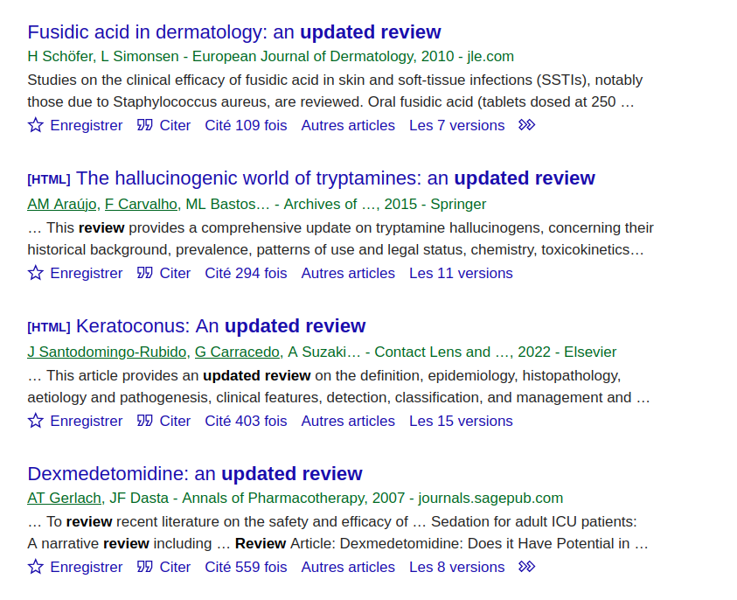
Other applications: Update existing reviews
The articles included and excluded from existing reviews can be used to train a model, which can then be applied to screen new search results (e.g. Cohen et al 2005 , Cohen et al 2009 ).
Mainly use in medicine reviews
Notes:
The articles included and excluded from existing reviews can be used to train a model, which can then be applied to screen new search results (e.g. Cohen et al. 2006, 2009).
Cohen AM, Ambert K, McDonagh M. 2009. Cross-topic learning for work prioritization in systematic review creation and update. J Am Med Inform Assoc 16: 690--704.
Cohen AM, Hersh WR. 2006. Reducing workload in systematic review preparation using automated citation classification. J Am Med Inform Assoc: JAMIA 13(2): 206--219.
This helps address the common problem of reviews quickly going out of date, and allows for timely updates

Slide 23
Machine Learning applications for metadata extraction et categorization
Oct 7, 14:00 - 15:00
Devi VEYTIA
Postdoctoral researcher
École Normale Supérieure

Slide 24
Outline
TD: Decoder model for coding, RAG-AI
Other applications/examples
Conclusion

Slide 25
Introduction
Machine learning also has applications for describing the distribution and extent of literature with respect to metadata variables. Examples include:
Text classification using Encoder models (e.g. Callaghan et al. 2021, Veytia et al. 2025) → same principles behind the screening TD
Coding/data extraction using Decoder models (e.g. Elicit, Veytia et al. In Prep.)
Predictive labelling (e.g. Colandr)

Slide 26
What is a transformer model?
Text classification, where the model must classify a piece of text into one of several predefined categories.
The encoder takes in a sequence of tokens and produces a fixed-size vector representation of the entire sequence, which can then be used for classification.
Language generation, where the model must generate a sequence of words based on an input prompt or context.
The decoder takes in a fixed-size vector representation of the context and uses it to generate a sequence of words one at a time

Slide 27
TD: Decoder block for coding
Literature review example:
Complex coding task where the input texts and the outcomes sought are highly heterogeneous (implying LARGE amounts of data to train trying to train a sequence classification model)
A logic/rule based Q&A approach makes sense given the input text and information you want to extract
Examples:
Coding biodiversity impacts across a range of different interventions (MREs, mCDR, CCS, …)
Analyzing a full text pdf
Notes:
then predict which tokens should come next

Slide 28
TD: Decoder block for coding
To predict the next word (token):
Each possible token is assigned a probability according to a probability distribution.
The LLM temperature parameter modifies this distribution.
A lower temperature makes the tokens with the highest probability more likely to be selected (ie. coherence)
a higher temperature increases a model's likelihood of selecting less probable tokens (more creative)
Different temperature settings introduce different levels of randomness and allow you to balance how the model performs.
A decoder is almost the same structure as the encoder → designed to predict the next word in a sequence given the previous words. See this illustration
Therefore, it is important to recognize that each time you run the model, your results might change due to randomness.
TD sections: Example 1: Coding using a generative LLM
Notes:
then predict which tokens should come next

Slide 29
TD: Decoder
Tools: ($): ChatGPT, Elicit, (Free): DeepSeek, Google Flan, other models on HuggingFace
Considerations:
Validating prompts for adequate performance is still time-consuming
No commonly established method/practice for this application
Hallucination (although things you can do to minimize this)

Slide 30
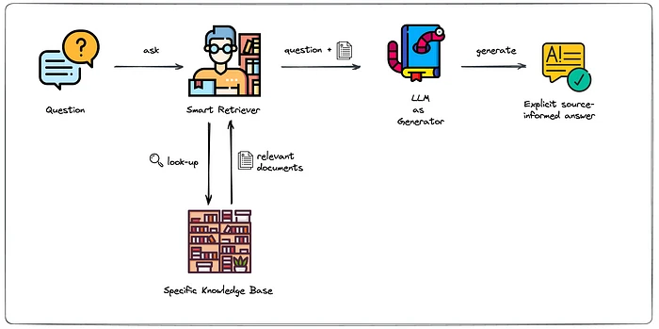
TD: RAG-AI
Retrieval-Augmented Generation (RAG) allows an LLM to reference a specific knowledge base (context) outside of its training data sources before generating a response. This allows you to ask an LLM to answer questions about a source text.
TD sections: Example 2: RAG-AI

Slide 31
TD: Using pre-trained models for coding
You can use pre-trained models off the shelf – applying existing models for predicting classifications on Huggingface to predict labels for unseen data (e.g. sentiment analysis, location extraction, etc.)
TD sections: Example 3: Code using a pre-trained classification model

Slide 32
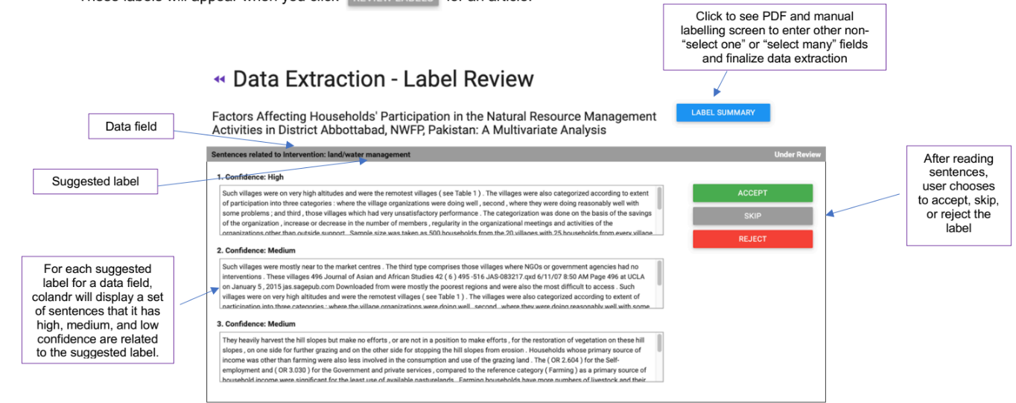
Other examples: Predictive labelling
Provide suggestions to expedite data extraction (e.g. Colandr)
Notes:
“After you have manually labeled the minimum 35 articles to inform the machine learning and natural language processing model, colandr will begin to suggest labels for any data fields that are set to “select one” or “select many.” These labels will appear when you click for an article.”

Slide 33
General advice
When using ML methods:
Make sure your method is appropriate for the question. Use the strengths of AI, while being aware of its limitations. AI is great at summarizing large amounts of documents, and detecting overall patterns and trends in data. So it’s great for tasks like priority screening or supervised/unsupervised systematic maps, but can’t replace humans when it comes to critical assessment of literature/interpretation
Consider sources of error, bias, and how you’re evaluating your model performance, and interpreting its results
But, humans have error too…

Slide 34
Need for machine learning literacy in evidence syntheses community
No substitute for domain-specific expertise, but literacy in ML methods is also needed.
While there are increasing numbers of online platforms that make ML models user-friendly without need to code, still limited in how customizable they are.
Without experience, researchers may have unrealistic expectations of what the ML system can achieve
Needed for assessing whether a model is fit for purpose. Eg. Accuracy vs F1 score

Slide 35
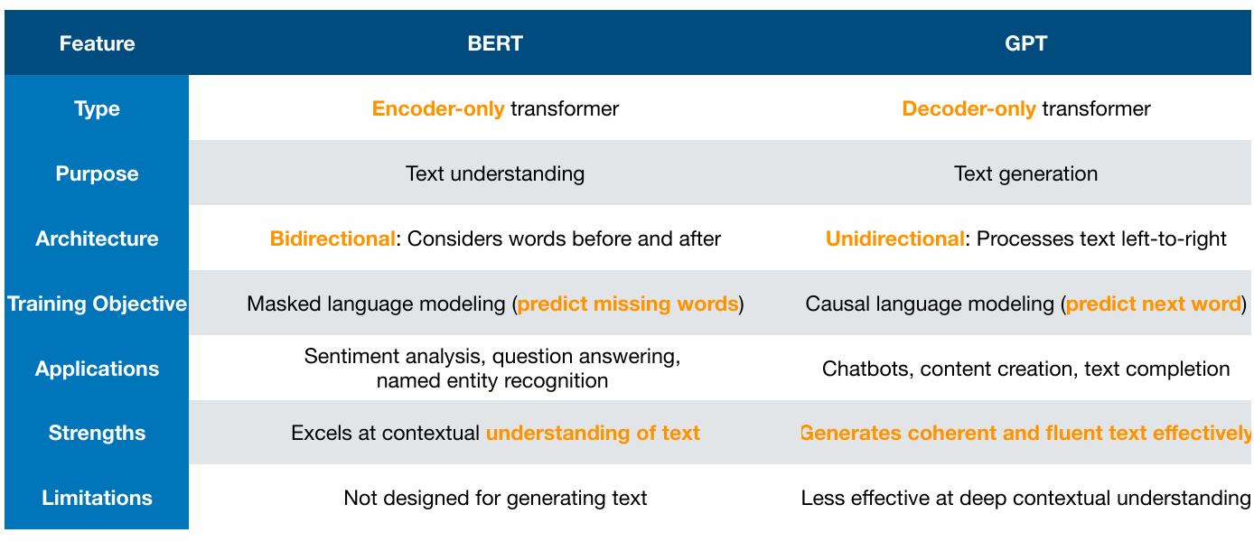
Summary of encoder vs decoder transformers
Source: Nicolas Schreuder, CNRS, LIGM

